Slide 1

Knee OA Classification Using Bone Distance
Viswanathan appakkudal ramani

Slide 2
What is Osteoarthritis (OA)?
Wearing down of cartilage that protects the bones
Facts:
Research: People over 40 years have 90% chance of getting knee OA, if they have a small knee pain
OA grows gradually over years, and Orthopedists could foresee it well before years
Causes:
Less physical activity and body weight
Managing OA:
Exercises recommended by Physiotherapist
Body weight

Slide 3
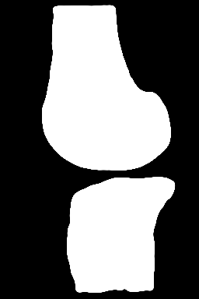
Into the CV world!
Dataset:
Features: 160 2D images for every 193 cases with/without OA
Target: 65 cases with ‘A’ grade OA, and 128 cases with ‘B’ grade
About Images:
Pre-segmented images of 3D MRI images
Image has femur and tibia bones of every case and a tiny/large gap in-between the bones. (In the medical world this small/large gap corresponds to the cartilage)
Femur
Tibia

Slide 4
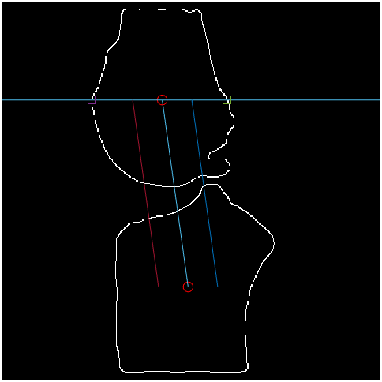
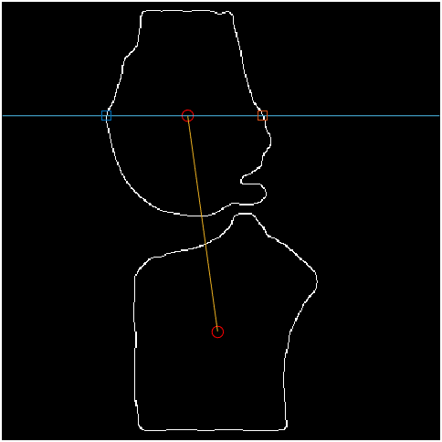
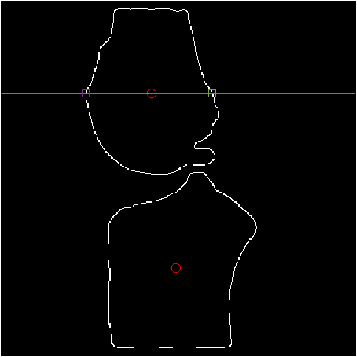
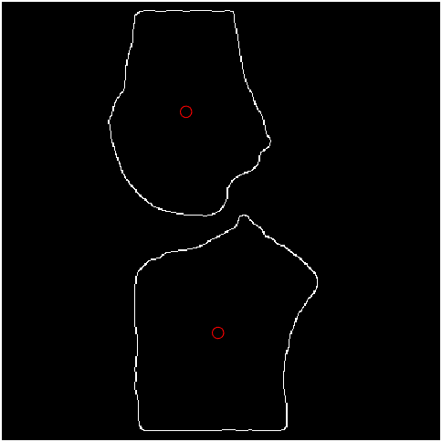
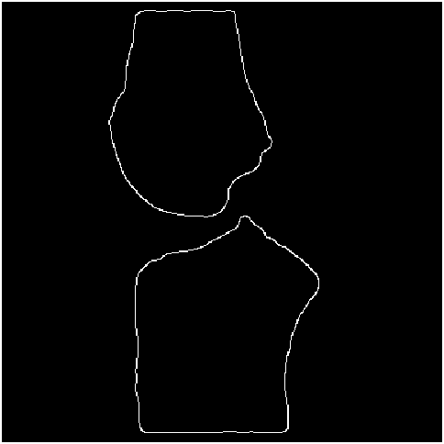
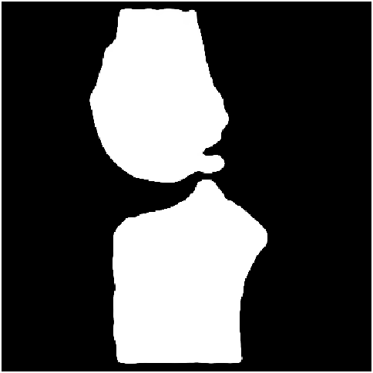
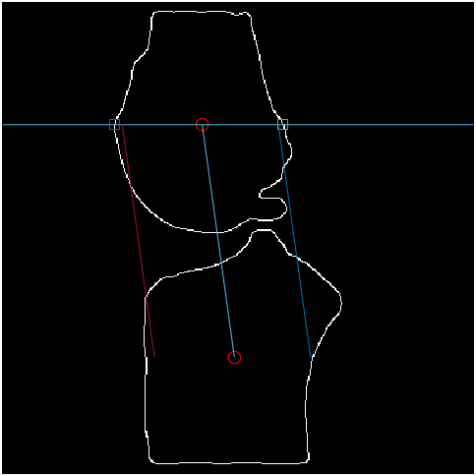
Finding the distance - Process
1) Using Canny Detector to find the edges
2) Finding the centroids of Femur and Tibia bones
3) Finding the horizontal edges along the Femur Centroid point
4) Drawing the line connecting both centroids
5) Moving the lines parallel to the obtained regression line
6) Maximum limit range
Distance Metric: Euclidean distance

Slide 5
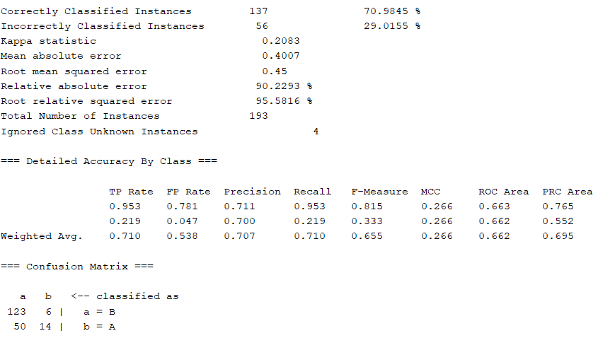
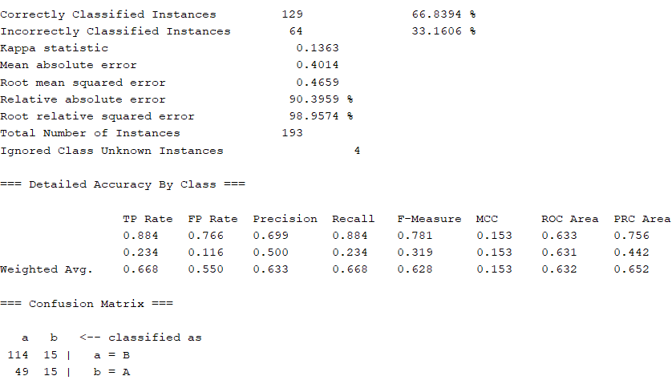
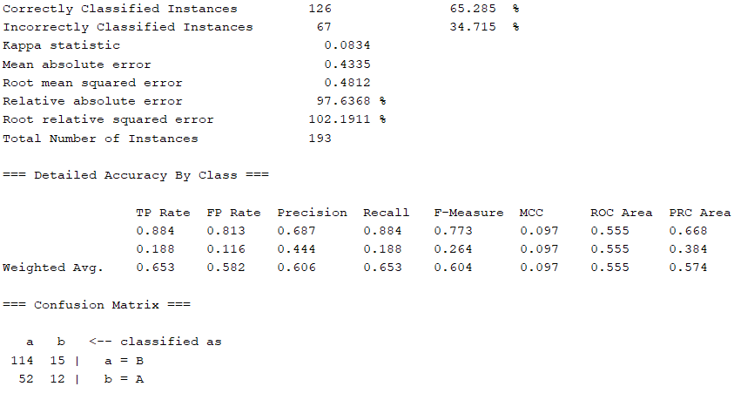
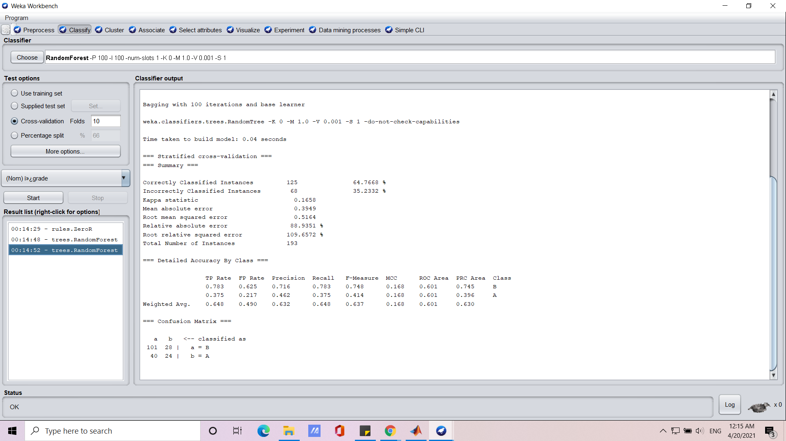
The Art of Feature Engineering and Modeling
Model 4 : Random Forest
Features: 674 – White pixel count array, KL Gradescore, Euclidean distance at 5 points of intersection (start, center, and end)
Target: Grade
ROC Area: 70.98%
Accuracy: 67.3%
Model 3 : Perceptron
Features: 350 – White pixel counts
- Euclidean distance at 3 points of intersection (start, center, and end)
Target: Grade
ROC Area: 129
Accuracy: 66.8%
Model 2 : Perceptron
Feature: Average Euclidean distance (Norm)
Target: Grade
ROC Area = 58.4%
Accuracy: 65.28%
Model 1(Midterm): Random Tree
Feature: Minimum Euclidean distance
Target: Grade
ROC Area: 60.1%
Accuracy: 64.7%

Slide 6
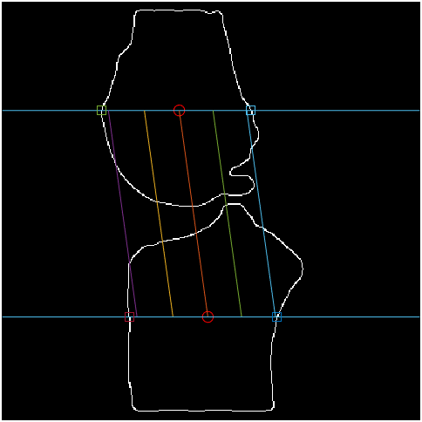
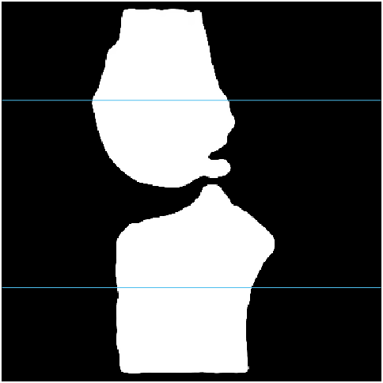
Feature Selection
1) KL grade scores
2) Pixel Count: Counting number of white pixels between the two centroids
3) Calculating distance across 5 points between femur and tibia bones
4) Total number of features = 13
Total datapoints considered = 193
Time to run the script ~= 2 hours

Slide 7
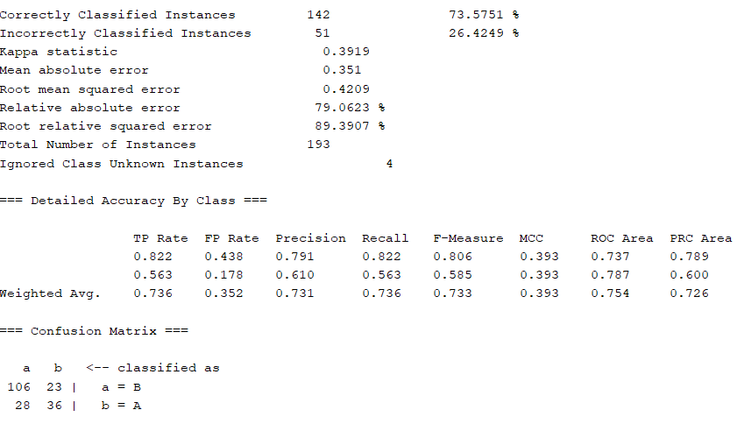
Model Selection
Model – Ada Boost
Accuracy – 73.57%
ROC Area – 73.7%

Slide 8

Questions/ Suggestion

